Slide 1
WSN@work Peter Van Aken / Alain Maes

Slide 2
Topics
Building nodes (workshop 1.x)
Exploring sensors/actuator
Learning RF/electronics
Writing firmware
Configuring controller (workshop 2.x)
Building gateway (workshop 3.x)
Use cases
Demo
Building

Slide 3
Learning Arduino ?
USB book stick
Jeremy Blum : “arduino tutorial series” (https://www.youtube.com/watch?v=fCxzA9_kg6s)
Information source : https://www.arduino.cc/
Workshops ☺

Slide 4
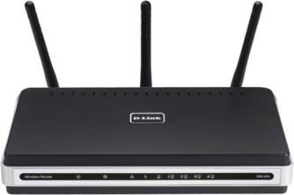
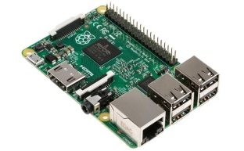
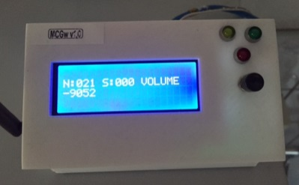
WSN@Work topology : workshops
http(s)://192.168.0.107
Open SSID : WSNatWork
Wifi : auto channel
(192.168.0.1)
LAN
192.168.0.x
2.x
3.x
Gateway
Controller
Nodes
1.x
Wireless Sensor Network

Slide 5
WSN@Work to WSN@Home : roadmap
http(s)://192.168.0.107
Open SSID : WSNatWork
Wifi : auto channel
(192.168.0.1)
LAN
192.168.0.x
YOUR LED Node

Slide 6
http(s)://192.168.0.107
Open SSID : WSNatWork
Wifi : auto channel
(192.168.0.1)
LAN
192.168.0.x
YOUR Controller
Gateway
YOUR LED Node

Slide 7
http(s)://192.168.0.107
Open SSID : WSNatWork
Wifi : auto channel
(192.168.0.1)
LAN
192.168.0.x
YOUR Controller
YOUR Gateway
YOUR LED Node

Slide 8
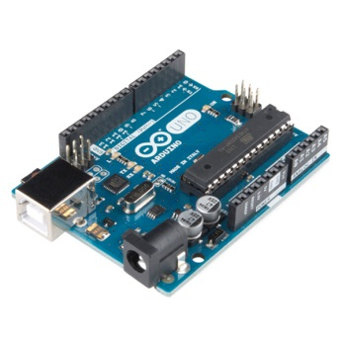
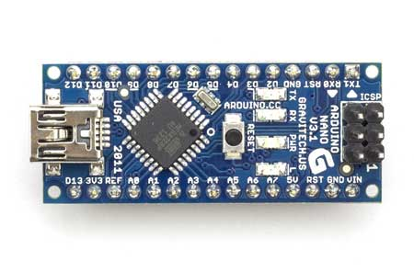
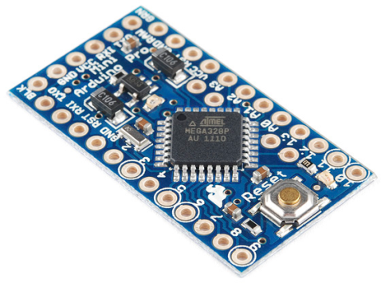
Platforms
1.x
Arduino (UNO, Nano, Pro mini)
Nordic NRF24L01+
Programming
Power
Programming
Power
5V / 16 MHz
3.3V / 8 MHZ (demo)

Slide 9
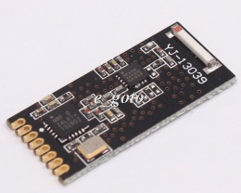
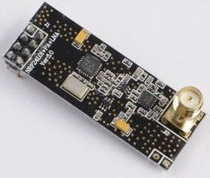
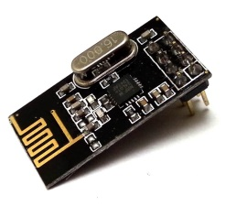
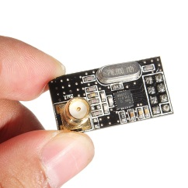
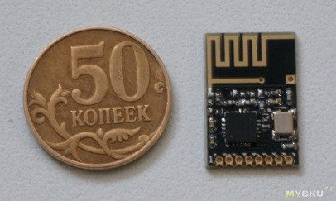
Platform NRF24L01+ models
1.x
PA/LNA : ceramic / SMA antenna ; mini & DIL
Open range : =< 1.1km
Application : gateway, ptp long range, no battery operation
No PA/LNA : different antennas ; mini & DIL
Open range : =< 100 m (in house : need meshing, don’t expect Wifi range !)
Application : sensor nodes, with or without battery operation

Slide 10
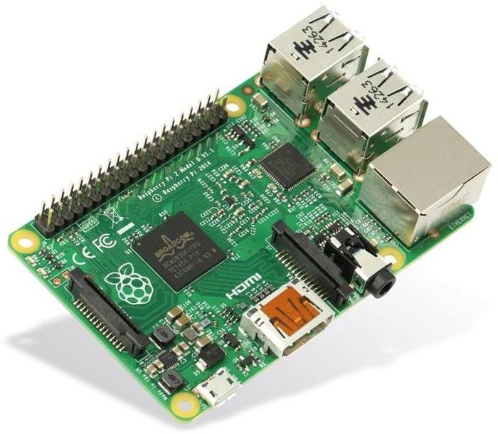
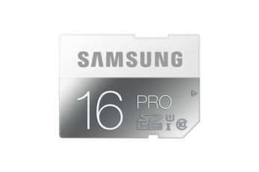
Platforms
2.x
Raspberry Pi v2.0 model B :
SoC : BCM2836 (900MHz)
1GB RAM
100Mbps 802.3 / 4 x USB 2.0
microSD
Accessories :
PowerSupply : 5V+2A(!)
microSD : >= 16GB Class 10 (!)
Case (optional)
HDMI cable / USB keyboard / mouse
UK product (Alie not recommanded for platform but accessories are OK)

Slide 11
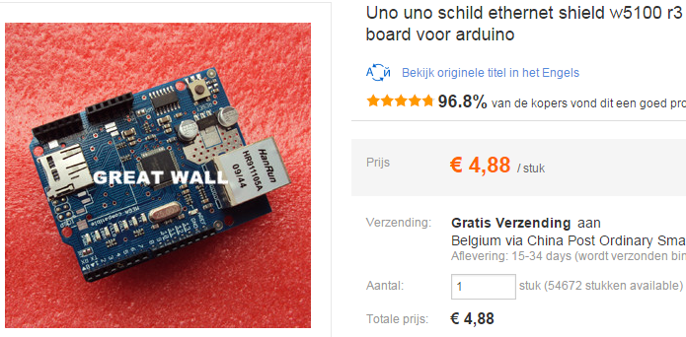
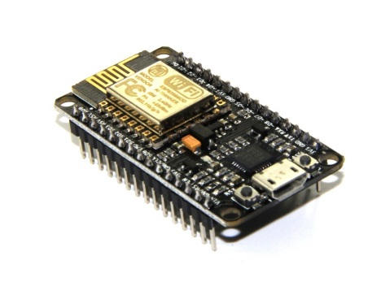
Platforms
3.x
Wired : Arduino Ethernet Shield W5100
Wifi : ESP8266 – NodeMCU ?

Slide 12
Arduino Programming
In system programming (ISP)
Serial bootloader (Optiboot/…)
Note : powered USB hub = extra protection
On board USB
FDTI (http://nl.aliexpress.com/item/Free-Shipping-1PCS-FT232RL-FT232-USB-TO-TTL-5V-3-3V-Download-Cable-To-Serial-Adapter/32340783857.html?ws_ab_test=searchweb201556_6_79_78_77_82_80_62,searchweb201644_0,searchweb201560_5)
OTA bootloader
MysBootloader
DualOptiboot

Slide 13
ISP programming & fuse bits
USBtinyisp (with Arduino 1.6.5)
Burn bootloader
AVRisp mkII (AVR studio 4)
http://www.engbedded.com/fusecalc/
Fuse bits
Avr Dragon (AVR studio 4)
Debugging

Slide 14

LED node : code walk
Initialisation :
Presentation :
Sending/Receiving data :

Slide 15


Node addressing (RF)
Nordic Enhanced ShockBurst format
Address = WSN base@ (4bytes) || NodeId (1byte) (0/255 reserved)
WSNbase
2^32 WSNs with (254 nodes / freq) ; behind 1IP@
Distance vector based routing (EEPROM) : node2node distance = 1

Slide 16
MySensors Payload Format
lastNode:8 last node this msg passed
origNode:8 originating node of this msg
destNode:8 destination node for this msg
protocolVersion:3 version of mysensor protocol
payloadLen:5 length of sensor payloadData
msgType:3 presentation,set,req,internal,stream
reqAck:1 request ack from destination
isAck:1 msg is an ack from a destination
payloadType:3 sensor payload data type (str, byte, int16,long32,custom,float32)
subType:8 sensor sub-type, S_abc or V_abc
sensorID:8 ID of sensor within this node
payloadData depending on payloadType (max 25 bytes)

Slide 17
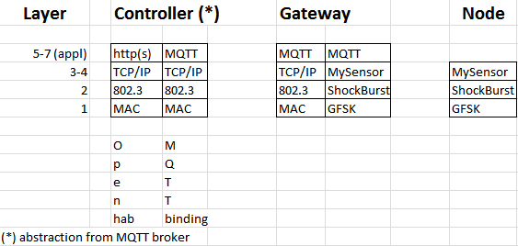
e2e WSNatWork stack
wired
RF

Slide 18
Packet Walk : node debug
MyConfig.h (SERIAL DEBUG)
Disable = 6% extra flash !
MYScontroller (demo) !! gateway interaction !!
http://www.mysensors.org/controller/myscontroller
NRF24 sniffer (demo : see next slide)
http://forum.mysensors.org/topic/242/wireless-nrf24l01-sniffer-for-mysensors

Slide 19
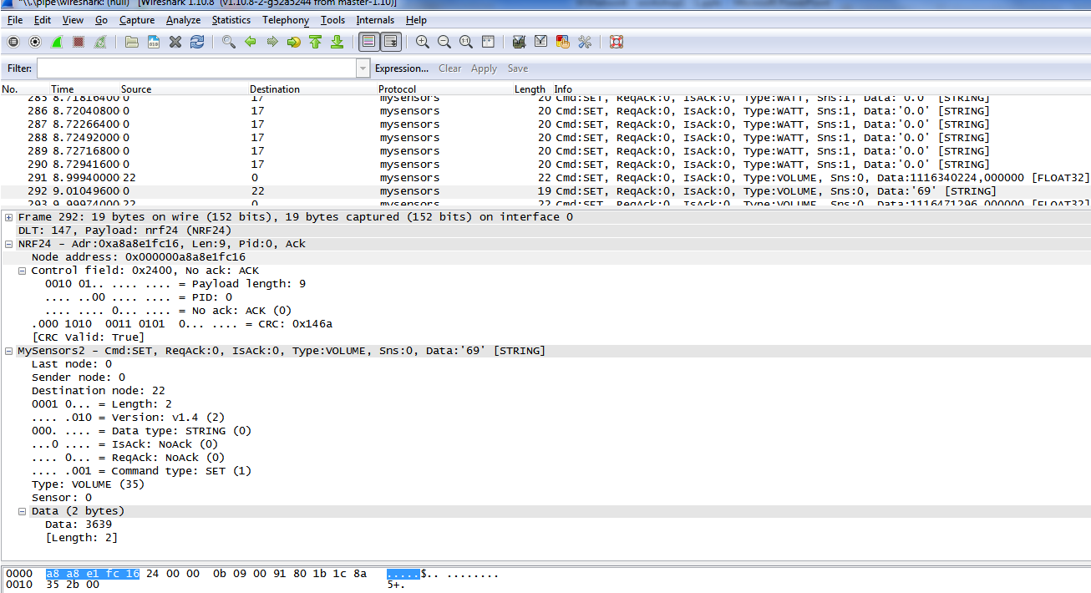
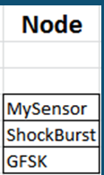
LED node : wireshark air capture

